Slide 1
SACHIN S
Final Project
3/21/2024 Annual Review

Slide 2
PROJECT TITLE
Medical Image Segmentation using Brain Tumor detection Dataset
3/21/2024 Annual Review

Slide 3


AGENDA
Problem Statement
Project Overview
Who are the end users?
Solutions and value of propositions
WOW factor in the solution
Modelling
Results
3/21/2024 Annual Review

Slide 4

PROBLEM STATEMENT
To develop an accurate and robust deep learning model for automatic brain tumor segmentation in MRI images, with the ultimate goal of assisting medical professionals in early diagnosis and treatment planning
3/21/2024 Annual Review

Slide 5

PROJECT OVERVIEW
Our project aims to develop an accurate deep learning model for automatically segmenting brain tumors in MRI images. This model has the potential to assist medical professionals in diagnosing and planning treatments more efficiently, ultimately improving patient outcomes. Through rigorous training and evaluation, our results demonstrate the effectiveness of the model in accurately delineating brain tumors, showcasing its potential for clinical use.
3/21/2024 Annual Review

Slide 6

WHO ARE THE END USERS?
Medical Professionals: Radiologists and oncologists using the model to enhance diagnostic accuracy and treatment planning.
Research Institutions: Academics and researchers analyzing brain tumors, seeking advancements in medical imaging techniques.
Healthcare Organizations: Hospitals and clinics adopting AI tools for improved patient care and operational efficiency.
Patients: Indirect beneficiaries through quicker, more accurate diagnoses and personalized treatment plans.
3/21/2024 Annual Review

Slide 7

YOUR SOLUTION AND ITS VALUE PROPOSITION
Solution:
Develop a deep learning model for automatic brain tumor segmentation in MRI images.
Value Proposition:
Efficiency: Automates segmentation, saving time for medical professionals.
Accuracy: Provides precise delineation of tumor regions, aiding in early diagnosis.
Clinical Utility: Enhances quality of patient care by improving treatment planning.
Scalability: Applicable across medical institutions, leveraging publicly available datasets and advanced algorithms.
3/21/2024 Annual Review

Slide 8

THE WOW IN YOUR SOLUTION
WOW Factor:
Innovative Techniques: By integrating both Convolutional Neural Networks (CNNs) and Vision Transformers (ViTs), we explored the versatility of modern deep learning architectures, offering a multifaceted approach to tackle the segmentation task.
Visualization Excellence: Through visualizations such as model architectures, training curves, and confusion matrices, we provide clear insights into our model's performance and efficacy, enhancing transparency and interpretability
.
Clinical Impact: With a focus on early diagnosis and treatment planning, our model aims to assist medical professionals in improving patient outcomes, underscoring the transformative potential of AI in healthcare.
Future Prospects: By setting a benchmark in medical image segmentation, our project lays the foundation for further advancements in the field, fostering ongoing innovation and progress in the diagnosis and management of brain tumors.
3/21/2024 Annual Review

Slide 9
MODELLING
1. Convolutional Neural Networks (CNN)
Architecture: Sequential model with Conv2D and MaxPooling layers.
Training: Optimizer: Adam, Loss Function: Binary Cross-Entropy.
Evaluation: Achieved 84.31% accuracy on test data.
Visualization: Confusion matrix for performance assessment.
2. Vision Transformers (ViT)
Patch Creation: Extract patches from input images.
Patch Encoding: Encode patches using Dense layers.
Data Augmentation: Random flip, rotation, zoom.
Training: Parameters include learning rate, weight decay, batch size, and epochs.
3/21/2024 Annual Review

Slide 10
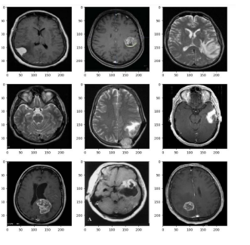
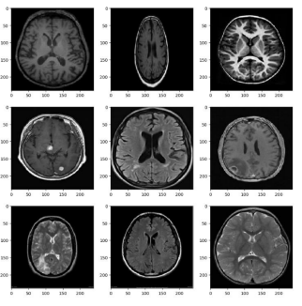
RESULTS
Data set Images
For YES
For NO
Demo Link
https://colab.research.google.com/drive/1_DZ-8jlqG4c89UgVv-xEg1hWhYnQfRea?usp=sharing
3/21/2024 Annual Review

Slide 11
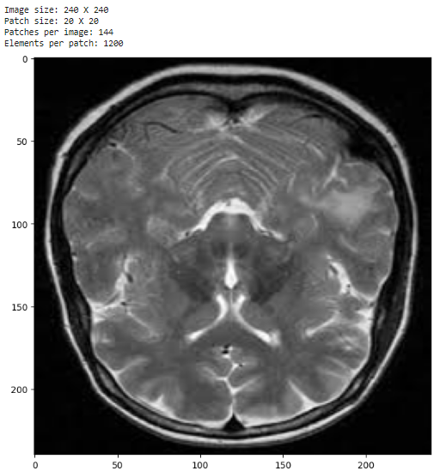
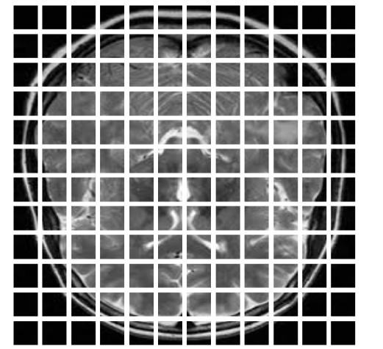
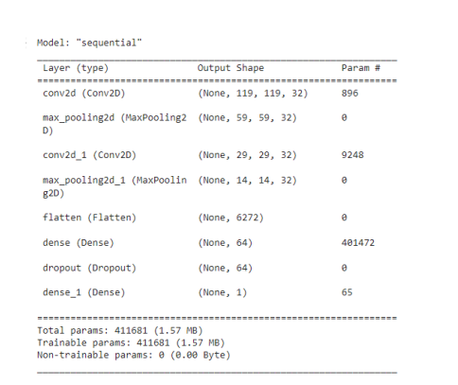
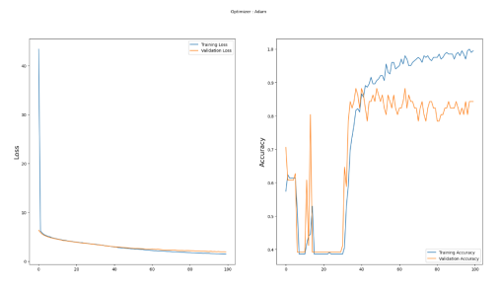
RESULTS
Output IMAGES
CNN evaluation
Demo Link
https://colab.research.google.com/drive/1_DZ-8jlqG4c89UgVv-xEg1hWhYnQfRea?usp=sharing
3/21/2024 Annual Review

